Slide 1
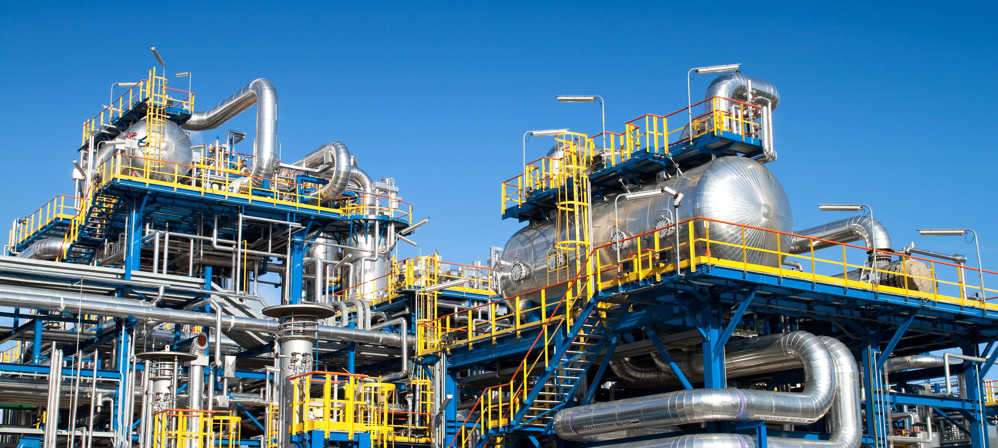
Portrait of the German chemical industry
Data and facts at a glance
© cobalt/stock.adobe.com
Status: April 2024 (automatic translation of the German version)

Slide 2
Table of contents
Industry portrait - key figures at a glance 2023
Importance of the sector and driving force of the industry: shares in the manufacturing industry
Raw material base of the chemical industry
Value chains, sales structure and new value creation structures
Innovation driver of a circular future, digitalisation as an enabler of a circular economy
Global players and SMEs
Employment and training
Energy-intensive industry
Strong research sector
Strong investment in Germany
Export-orientated industry
Foreign investments, market development strategies and subsidiaries abroad
Further information

Slide 3
The industry at a glance - key figures 2023
Wide product range
Sales: 225 billion euros, of which over 60 % abroad
Rank 1 in Europe, rank 3 worldwide
Production growth over the last 5 years: -3.3 % per year
479,500 employees, highest figure for 25 years
Domestic investment in property, plant and equipment: 9.4 billion euros, abroad: 12.7 billion euros
R&D expenditure: around 15 billion euros
Share of SMEs (extended definition): 96% of companies, 58 per cent of chemical employees (275,000 employees), 55 per cent of chemical and pharmaceutical sales
Sources: Federal Statistical Office, VCI

Slide 4
Importance of the sector for the economy as a whole
Indirect effects
Direct effects
Induced effects
Demand from chemical and pharmaceutical companies for materials, services etc. in other sectors creates employment and added value there.
Employees and value added in the sector (2020):
464,400 employees
60 billion value added
The spending and consumption of people employed in the sector generates employment and added value in other sectors.
Overall economic effect
The industry directly contributes around 2 % to Germany's value added.
Every job in companies in the sector leads to around 2 additional jobs in the German economy. In 2020, this amounted to around 900,000 people.
Every euro of direct added value generated by companies in the sector triggers a further 0.8 euros of additional added value in the German economy. In 2020, this amounted to around 48 billion euros.
Sources: IW Cologne, VCI

Slide 5
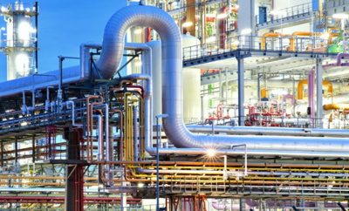
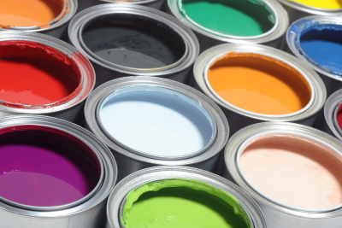


Chemistry is at the beginning of many value chains
Processing industry
Manufacturers of consumer and capital goods
Basic chemistry
Speciality chemicals
JT Jeeraphun/stock.adobe.com
rockpix/stock.adobe.com
irina/stock.adobe.com
scharfsinn86/stock.adobe.com

Slide 6
The sector is at the heart of Germany as an industrialised country
It is capital-, research- and energy-intensive and export-orientated
Key figures at a glance
In 2023, the German chemical and pharmaceutical industry only generated 9.6 per cent of turnover in the manufacturing sector - significantly less than in previous years due to the sharp downturn.
Research and development (R&D) and investments are of great importance in the industry.
The chemical industry is energy-intensive.
The industry is active worldwide and faces international competition.
Share of the sector in the manufacturing industry, 2023
Sources: Destatis, Stifterverband, VCI

Slide 7
The sector ranks fifth among industrial sectors in Germany
Share of turnover in the manufacturing industry
In 2023, the German chemical and pharmaceutical industry only generated 9.6 per cent of turnover in the manufacturing sector.
For the first time, the sector slipped to fifth place - after vehicle construction, mechanical engineering, the food industry and electrical engineering.
However, the gap between the food industry and the chemical and pharmaceutical industry is small.
In per cent, 2023
Sources: Destatis, VCI

Slide 8
Domestic production is further processed within the industry
Sales structure of the chemical-pharmaceutical industry in Germany
2020
In Germany, one third of domestic production goes directly to consumption and 5 per cent to the service sector.
Over 60 per cent of production is further processed within the industry (excluding pharmaceuticals, the proportion rises to 83 per cent).
Due to the high vertical integration of the industry, further processing mainly takes place within the chemical and pharmaceutical industry. The chemical industry itself is its best supplier and customer.
Source: Destatis, VCI

Slide 9
Main customers for chemical products in Germany: plastics processors
Chemical and pharmaceutical industry sales to other industrial sectors
2020, excluding deliveries to the chemical industry, DL, consumption and abroad
The industry's main customers are plastics processors. Vehicle construction follows in 5th place.
However, only direct sales are taken into account here. If indirect deliveries (via plastics processors, the electrical industry, the textile industry and mechanical engineering) are included, around 15-20 per cent of domestic production goes to the automotive industry.
Source: Destatis, VCI

Slide 10
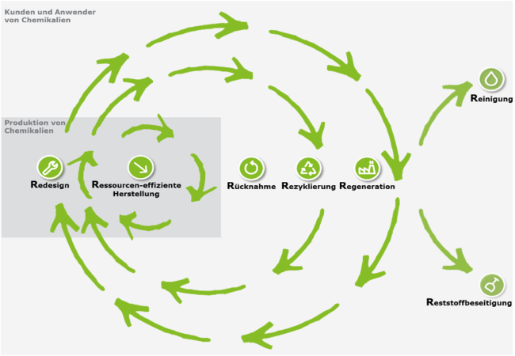
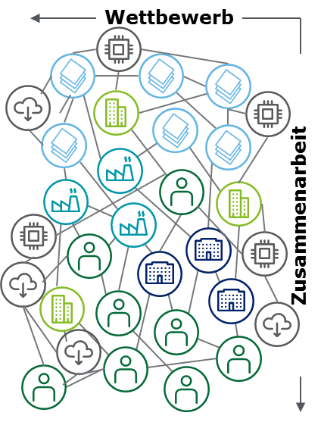
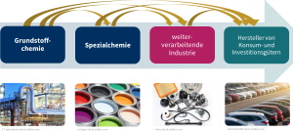
New value creation structures are emerging
Global value chains
Circular economy
Digitalisation and networking
Chemistry:
Growth and innovation driver
At the beginning of global value chains
Threat of slow growth, erosion of innovation advantages and location disadvantages
Chemistry:
Enabler of the circular economy
Efficient and climate-friendly production
An essential part of global value creation cycles
Chemistry:
exploits the opportunities of digitalisation
develops new business models
New distribution of roles in global value creation networks

Slide 11
Chemistry: driving innovation for a circular future
Circular economy
Resource base | Resource efficiency | Conservation of resources | Circular economy
Renewable
Energy
Renewable raw materials
Secondary raw materials
Throughout the entire product life cycle:
Supplier
Production
Customer
Climate protection
Preservation of ecosystems
Redemption
Reuse
Material and energy recovery

Slide 12


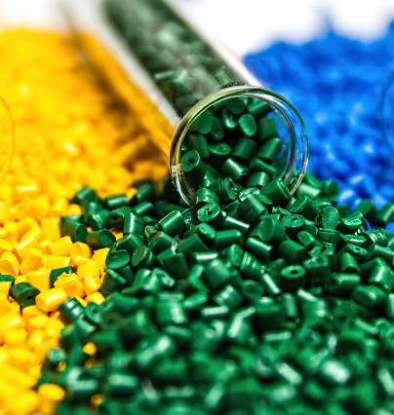
Digitalisation advances the circular economy
Sashkin/stock.adobe.com
Roman Milert/stock.adobe.com
mrmrsmarcha1/stock.adobe.com
Blockchain solutions to enable the traceability of materials in the value chain
Digital currencies to incentivise the collection of plastics in developing countries
Digital platforms for trading high-purity recycled materials

Slide 13
Many global players in the chemical and pharmaceutical industry
The 20 German chemical companies with the highest turnover in 2021
Many globally active chemical and pharmaceutical companies have their headquarters in Germany.
Large chemical companies often supply preliminary products that SMEs process into end products. This distinguishes the chemical industry from other sectors.
Source: Die Welt (19 July 2021)

Slide 14
Germany in 3rd place - 10 largest countries produce 72 per cent of global sales
TOP 10 chemical and pharmaceutical producers in the world
Share of global chemical and pharmaceutical sales, 2022
China leads the international rankings by a wide margin.
Germany is gaining slightly on Japan.
The remaining countries in the TOP 10 have almost equal shares. There are frequent changes of position here.
Sources: Chemdata International, VCI
Note: International data differs from Destatis data.

Slide 15
96 per cent of companies are SMEs
Size structure of the chemical-pharmaceutical industry
Number of companies, employees and turnover by size category, 2022, shares in per cent
Almost all companies in the chemical and pharmaceutical industry are SMEs.
In 2022, this figure was around 2,000 companies.
With a good 275,000 employees, they employ almost 60 per cent of the sector's workforce.
SMEs generate 55 per cent of chemical and pharmaceutical sales.
The production of basic chemicals is the domain of large companies. Medium-sized companies then process these products into application-orientated fine and speciality chemicals, polymers and consumer chemicals.
New definition of SMEs: by company, up to 1000 employees
Sources: Destatis, VCI

Slide 16
Rising employment figures over the past 13 years
Employees in the chemical and pharmaceutical industry
in 1000
The German chemical industry is the sixth largest employer in Germany.
The sector offers secure and well-paid jobs and has increased employment in recent years (+65,000 employees since 2010).
With an average of over 69,000 euros in 2023, salaries in the sector are a good
a good 23 per cent above the average for the manufacturing sector.
Source: Destatis

Slide 17
The industry trains
Apprenticeships on offer in Germany
Number of training places in the chemical and pharmaceutical industry + parts of the rubber and plastics industry (delimitation: BAVC)
The chemical industry needs qualified and competent employees for technically demanding jobs. That's why it trains them itself.
Despite declining production, falling sales and ongoing uncertainty, the industry invested more heavily in training skilled workers: with 9,896 new training places on offer, the number of training places increased to a record level.
After successfully completing their training, over 90 per cent of trainees are taken on (2023: 94 per cent).
BAVC delimitation including parts of the rubber and plastics industry
Source: BAVC

Slide 18
The chemical industry is energy-intensive, but reduces energy consumption and emissions
Shares of the chemical and pharmaceutical industries in manufacturing consumption
Final energy consumption by energy source and total, 2022
The chemical industry accounts for a good 8 per cent of energy consumption in Germany and 22 per cent of energy consumption in the manufacturing industry. If the material use of energy sources is added, the sector accounts for over 30 per cent.
Since 1990, energy consumption in the sector has fallen by 22 per cent.
Overall, the industry is responsible for around 6.5 per cent of CO2 emissions in Germany. Compared to 1990, the industry has reduced its greenhouse gas emissions by 54 per cent.
Source: Destatis, VCI
Without material use

Slide 19
The German chemical and pharmaceutical industry is strong in research
Research and development expenses
External and internal R&D expenditure in the chemical and pharmaceutical industry in billion euros
The coronavirus measures slowed down research and development. The decline was more than offset in 2021.
According to the data now available, the R&D budget could still be increased in 2022 despite the difficult earnings situation.
The industry invests around 6 per cent of its turnover in R&D every year.
Only the automotive and electrical industries invest more in research and development.
Sources: Stifterverband, VCI
Notes:
The chemical-pharmaceutical industry has invested well over 10 billion euros in research and development in recent years.
R&D expenditure in the chemical-pharmaceutical industry is growing dynamically. Since 2008, expenditure has risen by an average of 3.6 per cent per year. This growth is no longer driven solely by expenditure in the pharmaceutical industry. R&D expenditure in the chemical industry has also increased.
In 2017, 55.5 per cent of internal R&D expenditure in the chemical industry was spent on experimental development, 38 per cent on applied research and around 6.5 per cent on basic research. In the pharmaceutical industry, almost 56 per cent was spent on applied research, 31 per cent on experimental development and around 13 per cent on basic research.
Note: All R&D expenditure (internal and external) carried out by industry is included (GERD delimitation).

Slide 20
Domestic investments are above the long-term trend
Capital expenditure on property, plant and equipment by the German chemical/pharmaceutical industry in Germany
in million euros and trend
bre
Turnaround in investment: Domestic investments have been rising strongly since 2010.
The transformation requires investment: According to the "Roadmap Chemistry 2050", additional investments totalling over 60 billion euros will be required by 2050.
However, the current crisis is again leading to a reluctance to invest.
Sources: Destatis, VCI
2023 Extrapolation based on target figures

Slide 21
German chemical industry is strongly export-orientated
German foreign trade in chemical-pharmaceutical products
The German chemical and pharmaceutical industry is export-orientated.
Exports and imports rose very dynamically in 2022 due to the sharp rise in prices. At the same time, the trade balance decreased slightly compared to the previous year. Import pressure was high.
In 2023, trade in chemical and pharmaceutical products declined due to poor demand at home and abroad.
Exports, imports and foreign trade balance in billion euros
Sources: Destatis, VCI
2023: Estimate based on preliminary data

Slide 22
Very dynamic growth in foreign investment
Investments in property, plant and equipment by the German chemical and pharmaceutical industry abroad
in million euros and trend
Foreign investment in the German chemical and pharmaceutical industry is highly dynamic. Since 2012, foreign investment has also exceeded domestic investment. The reasons for this:
  Globalisation strategy: participation in market growth
  More favourable raw material costs abroad
  Domestic barriers to investment
Source: VCI
2023 Extrapolation based on target figures
Notes:
Foreign investment is becoming increasingly important for chemical and pharmaceutical companies. Since 2012, foreign investment has exceeded investment in Germany. This is not only due to market development, but also increasingly for cost reasons.

Slide 23
Further information
Facts and figures on investments in the sector: Focus on investments
Facts and figures on research and development: Germany as a centre of innovation
Facts and figures on energy and raw materials:
Energy statistics at a glance
Facts and figures on the global chemical markets: Chemical markets worldwide
Facts and figures on the industrial location: Germany as a centre of industry

Slide 24
VCI contact person
Christiane Kellermann
Senior consultant
Department of Economics
T I +49 (69) 2556-1585
E I kellermann@vci.de

