Slide 1
Chemicals & Pharmaceuticals – A Key Sector for Industry, Innovation and Transformation
Sector Profile July 2026

Slide 2
Chemicals & Pharmaceuticals: vital for Germany
Major industrial sector
The driving force behind industry, high-quality jobs, a strong SME sector
Key to transformation
Climate neutrality, the circular economy and a new raw materials base require the chemical industry
At the start of many value chains
A wide range of products; chemical products are used in almost all industrial sectors
Strong in research and exports, globalised
Highly innovation-driven and with a strong international position
Agenda for the future to ensure a strong business location
© industrieblick/stock.adobe.com, djemphoto /fotolia.com, seventy4/stock.adobe.com, Trueffelpix/stock.adobe.com

Slide 3
Dashboard 2025 – Industry Key Figures
€220 billion
Turnover
62% abroad
No. 1
in Europe (share of turnover)
No. 3
worldwide
No. 3
of industrial sectors in Germany
(share of
turnover)
476,300
Employees
2,100
companies
96% of which
are SMEs
€252.9 billion
Exports
€16 billion
R&D expenditure
€8.9 billion
Investments in Germany
€10.7 billion
abroad
Sources: Destatis, Chemdata International, Stifterverband, VCI

Slide 4
Dashboard 2025 – Key figures for the chemical industry
€158.4 billion
Turnover
62% in
abroad
No. 1
in Europe (share of turnover)
No. 3
worldwide
No. 4
of industrial sectors in Germany
(share of
turnover)
342,100
Employees
1,700
businesses
97% of which
are SMEs
€135.1 billion
Exports
€5.5 billion
R&D expenditure
€7.2 billion
Investments in Germany (2024)
Sources: Destatis, Chemdata International, Stifterverband, VCI

Slide 5
Dashboard 2025 – Key pharmaceutical figures
€61.9 billion
Turnover
63% overseas
No. 2
in Europe (share of revenue)
No. 4
worldwide
No. 10
of industrial sectors in Germany
(share of
turnover)
134,200
employees
350
businesses
92% of which
are SMEs
€117.8 billion
Exports
€10.5 billion
R&D expenditure
€2.6 billion
Investments in Germany (2024)
Sources: Destatis, Chemdata International, Stifterverband, VCI

Slide 6
Significant importance for the economy as a whole
Indirect effects
Direct effects
Induced effects
The demand from chemical and pharmaceutical companies for materials, services, etc. in other sectors creates employment and value added in those sectors.
Employment and value added within the sector
The spending and consumption of people employed in the sector generate employment and value added in other sectors.
Overall economic impact
The sector contributes directly to around 2 per cent of Germany’s value added.
Every job in companies within the sector leads to around two further jobs in the German economy.
Every euro of direct value added generated by companies in the sector triggers a further 0.8 euros of additional value added in the German economy.
Sources: IW Cologne, VCI

Slide 7
third-largest industrial sector
Share of turnover in the manufacturing sector
2025
In 2025, the German chemical and pharmaceutical industry accounted for almost 10 per cent of turnover in the manufacturing sector.
This makes it the third-largest industrial sector.
Sources: Destatis, VCI

Slide 8
At the heart of Germany as an industrial nation
Key figures at a glance
The sector’s share of the manufacturing sector in per cent, 2025
In 2025, the sector accounted for around 10 per cent of turnover in the manufacturing sector.
The shares of investment, research and development (R&D) and exports within the industry are significantly higher.
The sector is strong in terms of investment, research and exports.
Sources: Destatis, Stifterverband, VCI

Slide 9
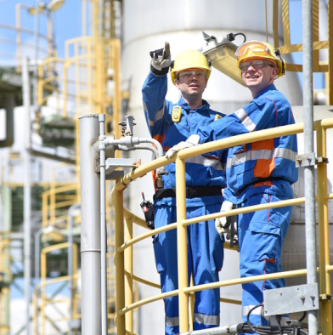


Attractive employer
Employees in the chemical and pharmaceutical industries
2000 to 2025
Sixth-largest employer in Germany
Average salary: €72,850
23% above the industry average
8,779 apprentices (-13% on the previous year)
Hiring rate: 89%
© Industrieblick/stock.adobe.com; M.Schuppich/fotolia.com; micromonkey/stock.adobe.cm
Source: Destatis, BAVC, VCI

Slide 10
Strong SME sector
Size structure of the sector
2025, percentages
approx. 2,000 businesses
276,000 employees
121 billion in turnover
Small and medium-sized enterprises process basic chemicals into application-specific fine and speciality chemicals, polymers and consumer chemicals
© qualitystockarts/stock.adobe.com; Gyro Photography/stock.adobe.com
Sources: Destatis, VCI

Slide 11
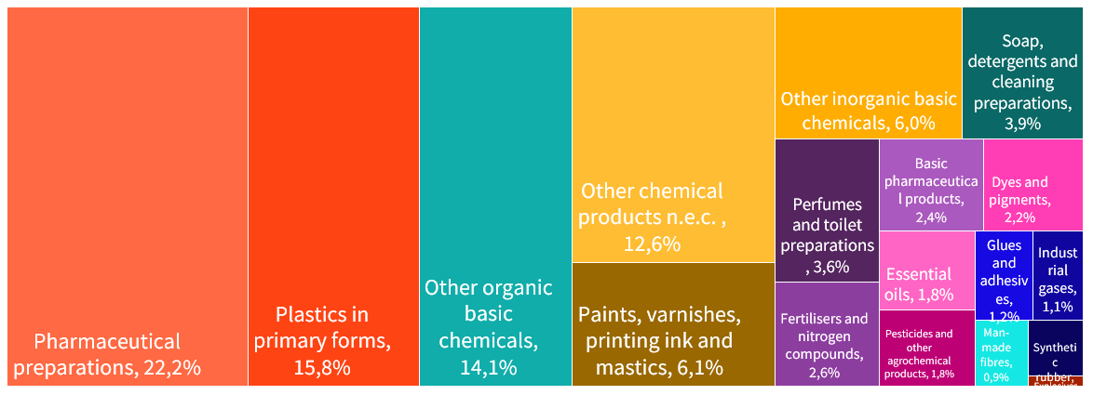
Wide product range
Product range
Share of each sector in the industry’s production value, 2025
Sources: Federal Statistical Office, VCI

Slide 12
CHEMICALS & PHARMACEUTICALS CONNECT GERMANY’S VALUE CHAINS WITH THE WORLD
INTERNATIONALLY CONNECTED
HIGH LEVEL OF IN-HOUSE MANUFACTURING
AN INDISPENSABLE SUPPLIER to industry and society
50 %
Overseas sales
of domestic intermediate inputs
come from the chemical and pharmaceutical sectors
52%
Plastics processing
CHEMICALS & PHARMACEUTICALS
24 %
Construction
Imported intermediate inputs
Automotive
>50 per cent
of domestic sales go to the chemical and pharmaceutical sectors
Healthcare…
Global sourcing and sales
connect the German chemical and pharmaceutical industry with the world.
The significance extends far beyond direct
supply relationships.
One in every two euros generated by the chemical industry is exported. The other half forms the foundation of value creation and public health in Germany.
Source: Destatis, VCI Data as at: 2023

Slide 13



Chemistry makes the future possible
Global value chains
Circular economy
Digitalisation and connectivity
Chemistry:
A driver of growth and innovation
At the start of global value chains
Products are used in almost every sector
Chemistry:
Enabler of the circular economy
Efficient and climate-friendly production
An essential part of global value cycles
Chemicals:
capitalises on the opportunities offered by digitalisation
develops new business models
new division of roles in global value creation networks
© djem/fotolia.com; narawit/stock.adobe.com; metamoreworks/stock.adobe.com

Slide 14
Strong in research
€16 billion
Expenditure on research and development
(R&D) in 2025
74 %
Proportion of research-performing companies
in 2024
7.3
R&D intensity in 2025
(as a proportion of
turnover)
47,100
R&D employees in 2024
15.3
R&D share of the manufacturing sector in 2024
No. 5
of the world’s innovation hubs in 2025
Source: Stifterverband, ZEW, VCI

Slide 15
globalised
Foreign trade in chemical and pharma products
FDI in the chemical and pharmaceutical sector
Exports, imports and foreign trade balance in billions of euros
Holdings in billions of euros
Sources: Destatis, VCI
Source: Deutsche Bundesbank, VCI

Slide 16
Strong in exports
German foreign trade in chemical and pharmaceutical products, in billions, 2025
EU
Exports
€128.5
Imports
€102.7
China
USA
Exports
€9.8
Exports
€36.7
€7.7
Imports
Imports
€22.4
Sources: Destatis, VCI
Notes:
16

Slide 17
A key sector for the transformation
Chemistry becomes a catalyst for transformation when innovation, infrastructure and alternative raw materials work in tandem.
Towards climate neutrality
Low-carbon processes, efficiency, electrification and green hydrogen.
01
02
Towards the energy transition
Materials for batteries, wind/solar, grids and H₂ infrastructure.
03
Towards the circular economy
Circular product design, recycling and closed material cycles.
04
Towards the bioeconomy
Bio-based raw materials and industrial biotechnology as renewable carbon sources.
05
Towards a raw materials transition
Recycled materials, biomass and CO₂ utilisation broaden the raw materials base.
Notes:
Five vision statements – a shared mandate for shaping processes, material flows and the raw materials base

Slide 18
Agenda for the future
Ensuring competitiveness:
Energy prices, red tape, regulation, location costs
Business conditions must make investment in Germany attractive again
Enabling transformation:
Climate-neutral processes, electrification, hydrogen, infrastructure
Climate neutrality requires affordable energy, grids, predictability and substantial investment
Germany as a sustainable hub for the chemical and pharmaceutical industries
Driving forward the raw materials transition:
Recycled materials, biomass, CO₂ utilisation, sustainable carbon
The sector needs access to alternative carbon sources and functioning circular economies
Accelerating innovation:
R&D, digitalisation, new business models
Innovation will determine future value creation and international competitiveness

Slide 19

Further information
Facts and figures on investment in the sector:
Focus on investment
Facts and figures on research and development: Germany as a hub for innovation
Facts and figures on energy and raw materials:
Energy, raw materials, prices
Facts and figures on global chemical markets: Chemical markets worldwide
Facts and figures on small and medium-sized enterprises:
SMEs in the chemical sector
Statistical compendium: The chemical industry in figures (CHIZ)
The chemical industry in figures
© armmy picca/stock.adobe.com

Slide 20
VCI contact person
Christiane Kellermann
Senior Manager, Economics Department
+49 69 2556 1585
kellermann@vci.de

